Slide 1
Lab 1 : introductory session

Slide 2
Write a python program to find the square root of given number from user
Lab 1: Introductory Session (Revision of basic python programs)

Slide 3
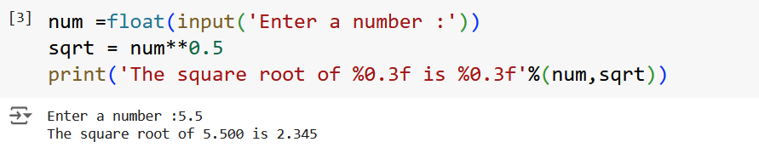
Program

Slide 4
Write a python program to swap two variables
Lab 1: Introductory Session (Revision of basic python programs)

Slide 5
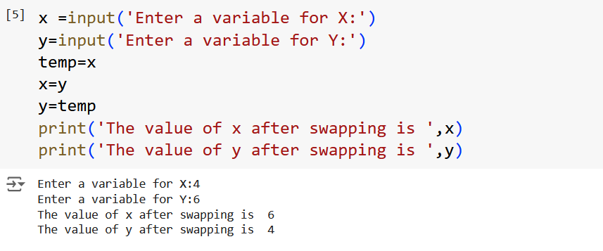
Program

Slide 6
Write a python program to check whether the given number is positive, negative or zero
Lab 1: Introductory Session (Revision of basic python programs)

Slide 7
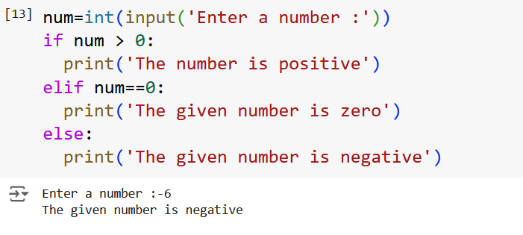
Program

Slide 8
Write the same program using nested if condition
Lab 1: Introductory Session (Revision of basic python programs)

Slide 9
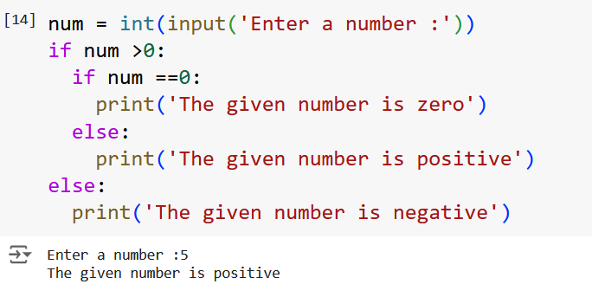
Program

Slide 10
Write a python program to find the given number is even or odd
Lab 1: Introductory Session (Revision of basic python programs)

Slide 11
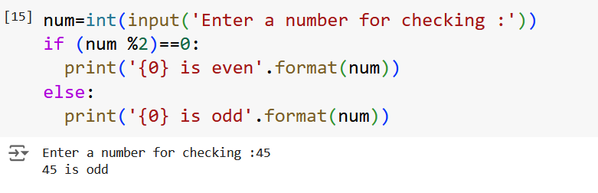
Program

Slide 12
Write a python program to find the factorial of a number provided by user
Lab 1: Introductory Session (Revision of basic python programs)

Slide 13
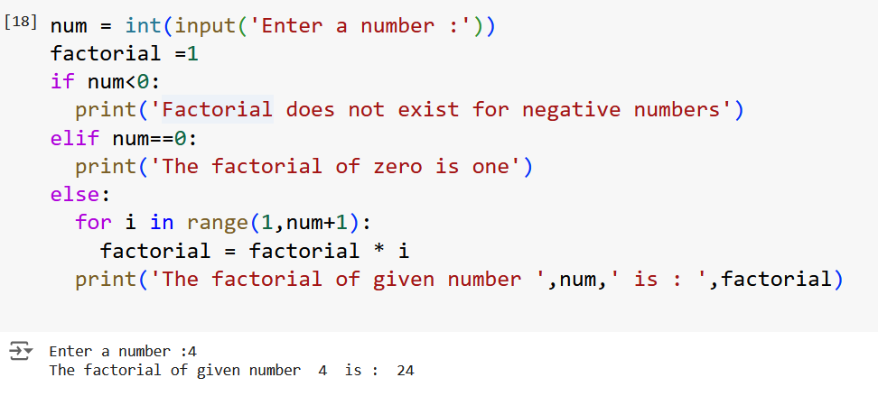
Program

Slide 14
Write a python program to find the sum of n natural numbers
Lab 1: Introductory Session (Revision of basic python programs)

Slide 15
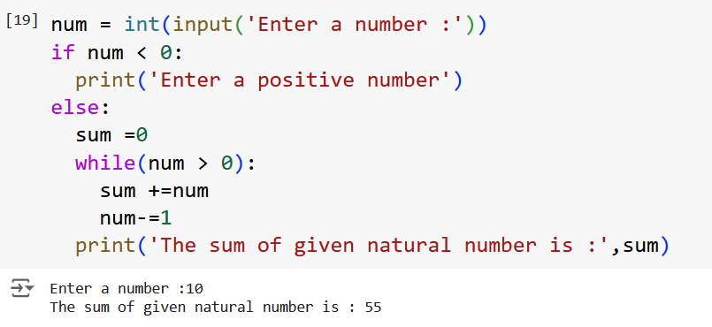
Program

Slide 16
Write a python program to display calendar of given month and year
Lab 1: Introductory Session (Revision of basic python programs)

Slide 17
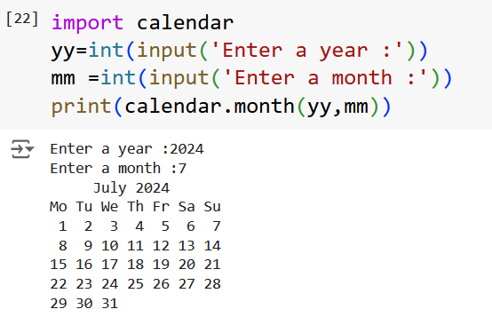
Program

Slide 18
Write a python program to add two matrices
Lab 1: Introductory Session (Revision of basic python programs)

Slide 19
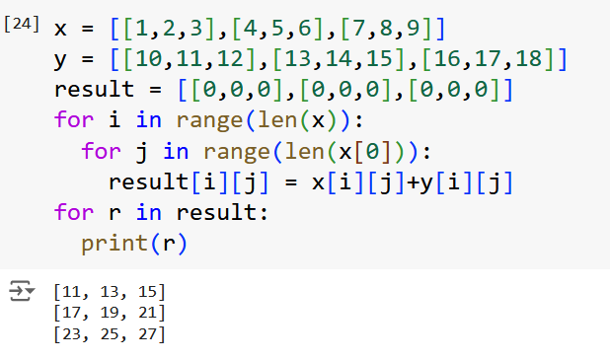
Program

Slide 20
Write a python program to transpose a given matrix
Lab 1: Introductory Session (Revision of basic python programs)

Slide 21
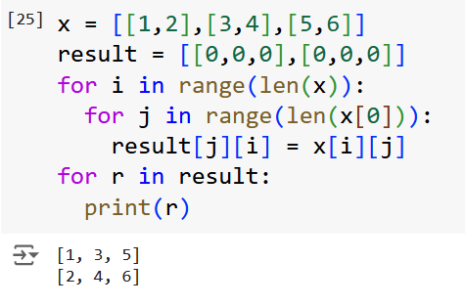
Program

Slide 22
Write a python program to check whether a given string is palindrome or not
Lab 1: Introductory Session (Revision of basic python programs)

Slide 23
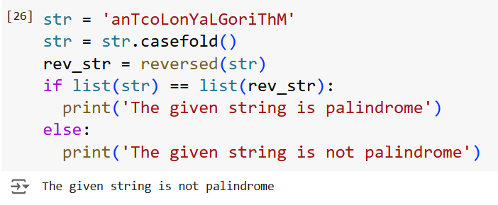
Program

Slide 24
thanks
AIML TEAM

